Slide 1

Know Your Rights
By – Sanika Chaudhari

Slide 2




Team members:
Sanika Chaudhari – SE-A-09
Titiksha Chaudhari – SE-A-10
Sarvesh Chavan – SE-A-11
Vishvajeet Chopade – SE-A-12

Slide 3
Introduction
Our idea is based on the constitution of India which helps a better understanding of the law to the citizen of India.

Slide 4

Basic Idea
The website is for the citizens of India.
In the website the articles are classified into the names which general users give such as domestic law, labor law, divorce law, land law , etc..
This website will help even a rookie to get the better understanding of the Indian constitution.
There will be news sections where the latest updates regarding the amends made will be posted regularly.

Slide 5

Constitution
In Indian constitution there are 12 schedule , 25 Parts and 395 Articles as of today .
The Schedule : tables which have additional information that is not mentioned in the articles.
The Parts: the constitution is divided into 25 parts and these parts define the set of articles eg. Citizen , fundamental rights
The Article: Article is nothing but a guideline and has a similar context in law to the section mentioned in various acts. Article is used to convey an impression that they are more elaborate and conventional in expression.

Slide 6
Indian Penal Code (IPC)
The Indian Penal Code (IPC) was the official criminal code in the Republic of India, inherited from British India after independences.
Prepared by the First Law Commission, chaired by Lord Thomas Babington Macaulay in 1834 and was submitted to Governor-General of India Council in 1835.
Under the IPC a person who has commited a crime is arrested or given an appropriate punishment.
But the Indian penal code is going to be replaced by the Bharatiya Nyaya Sanhita in December 2023. It was a comprehensive code intended to cover all substantive aspects of criminal law.
It will enter in force by 1 July 2024.

Slide 7

Show Stopers
You will find the collective information regarding our law and order on our website without searching high and low
As well each point will be explained in short to get better understanding .
For the help of victims of the domestic violence , harassment NGOs contact info and government helpline numbers will be given

Slide 8
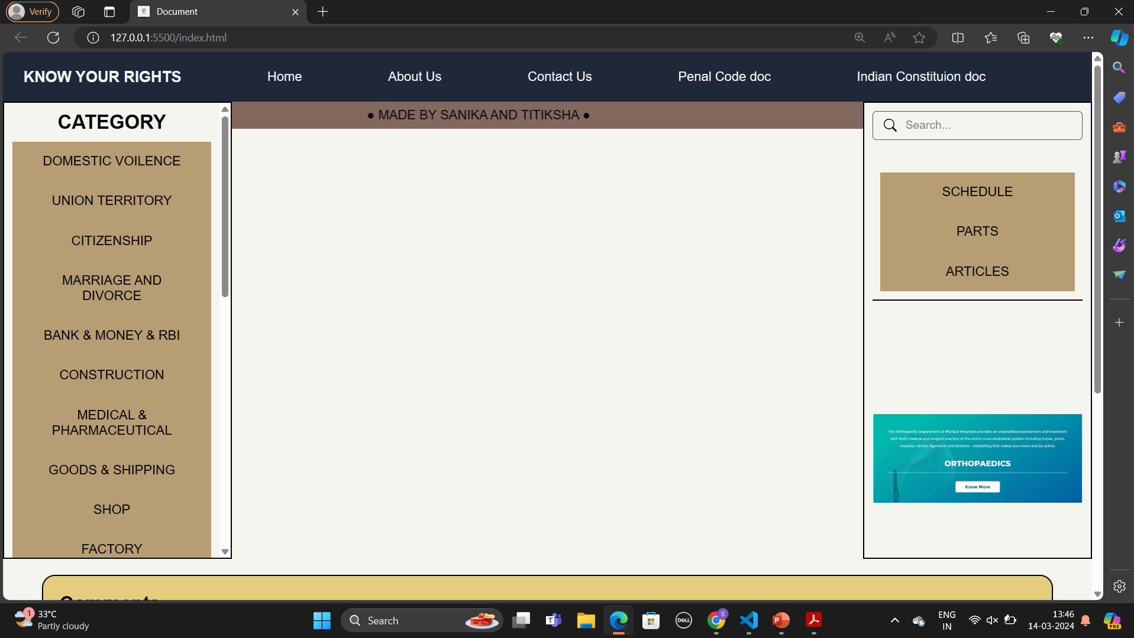
Website layout

Slide 9
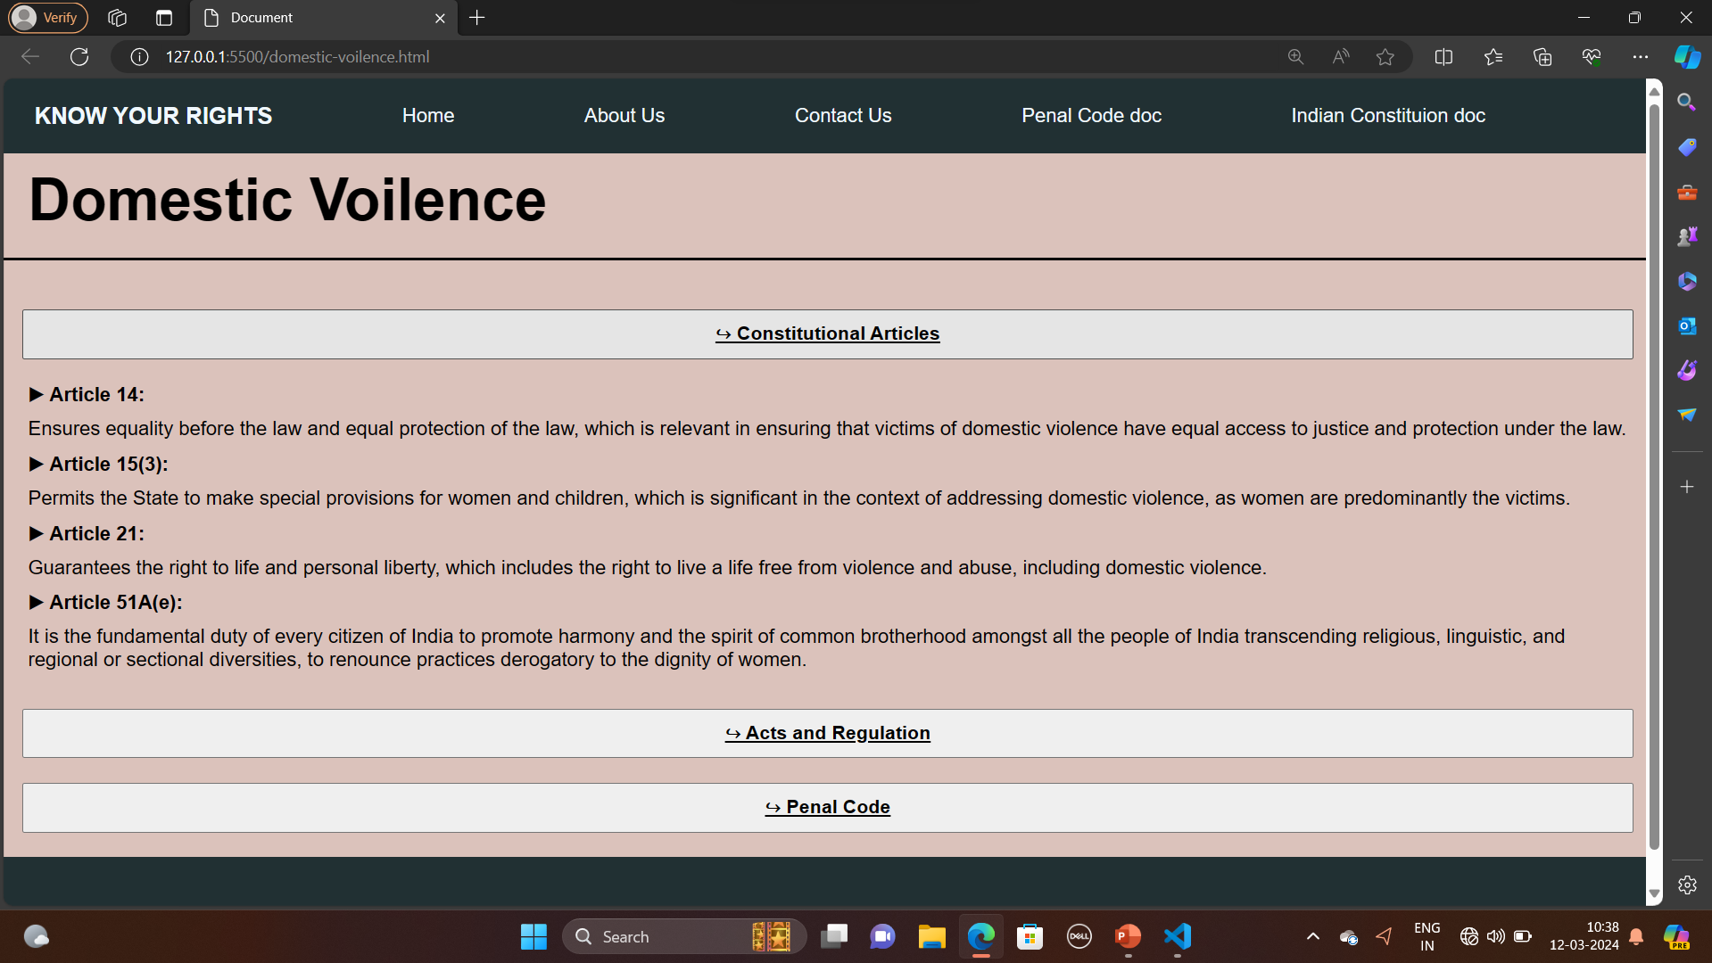
Website layout

Slide 10

Future scope
We can contact the lawyers at any time as per our need when ever required
You can get consultations from the best lawyers.
You chose the lawyers based on the review.

Slide 11


Thank You

Slide 12
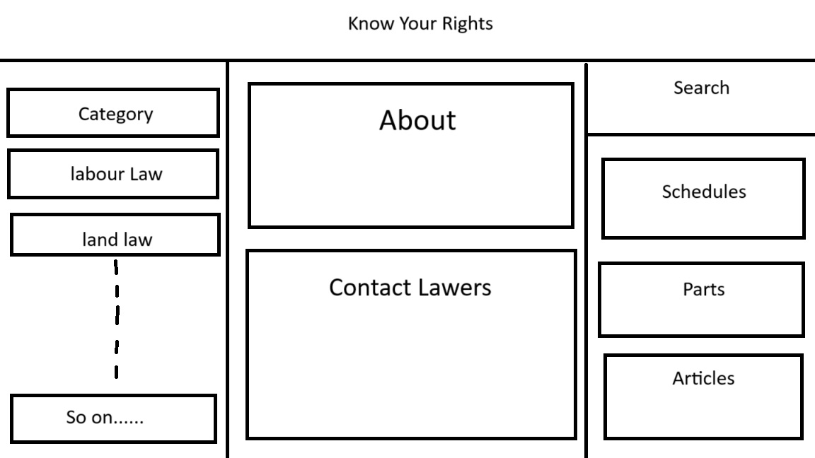
Website General Layout
Contact Lawyers

